Slide 1
Angular-17
Nagaraju

Slide 2
What is Angular
Angular is a JavaScript framework and development platform used to create single-page web applications. It's open-source and was developed and is maintained by Google. Angular is written in TypeScript, a superset of JavaScript, and includes a component-based framework, libraries, and developer tools

Slide 3
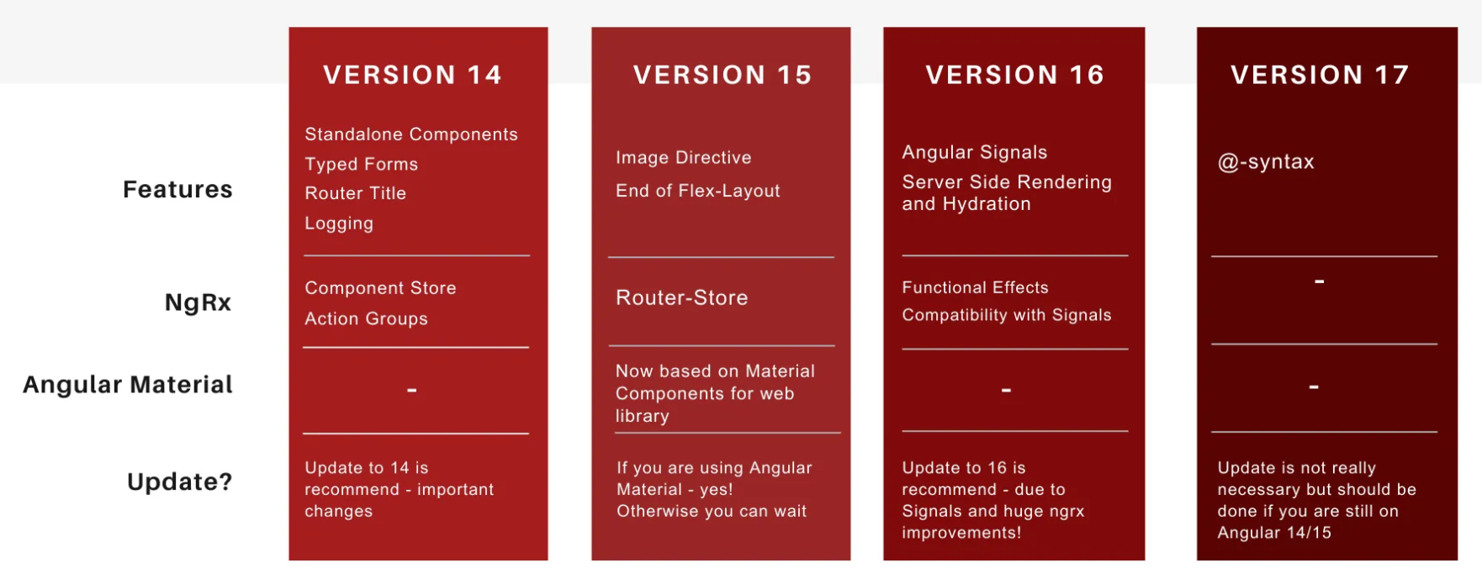

Slide 4
How to Installation
ng version
As we know already, Angular is written in TypeScript. We need Node and npm to compile the files into JavaScript after that, we can deploy our application. For this purpose, Node.js must be installed in your system. Hopefully, you have installed Node.js on your machine.
We check it uing the below command
Node –version or node –v
npm -v
Npm install –g @angular/cli @^17
Ng version

Slide 5
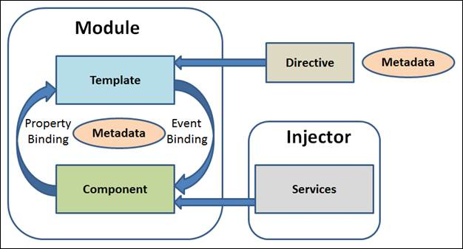
Angular architecture

Slide 6
How Add a component
What is component ?
Components are building block of Angular application. The main job of Angular Component is to generate a section of web page called view. Every component will have an associated template and it will be used to generate views.
Ng g c compname
What is Templates
The integral part of Angular component is Template. It is used to generate the HTML content. Templates are plain HTML with additional functionality.
Template url:’/app.ocomponent,html’,

Slide 7
What is data binding
Data binding deals with how to bind your data from component to HTML DOM elements (Templates). We can easily interact with application without worrying about how to insert your data. We can make connections in two different ways one way and two-way binding
Data Binding
One way
twoway
Property
event
<p>{{ title }}</p>
<input [(ngModel)]="name">
<img [src]="imageUrl">
<button (click)="onClick()">Click me</button>

Slide 8
What is Directive
Directives are DOM elements to interact with your application. Generally, directive is a TypeScript function. When this function executes Angular compiler checked it inside DOM element. Angular directives begin with ng- where ng stands for Angular and extends HTML tags with @directive decorator.
Directive
Component Directives
Structural Directives
Attribute Directives
Components are directives that include a template that is rendered in the place of the component.
Ng style
if
for
<p [ngstyle]=“{‘color’:’blue’,’font-size:’14px’}”>
switch
ifelse

Slide 9
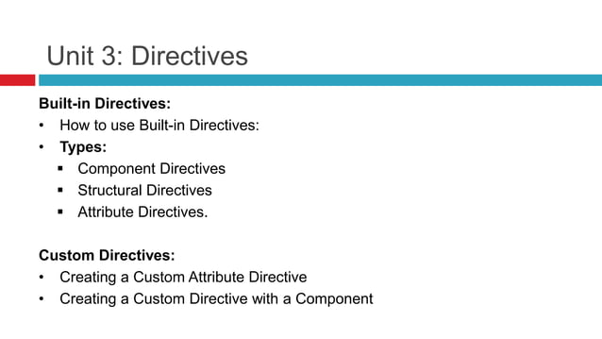

Slide 10
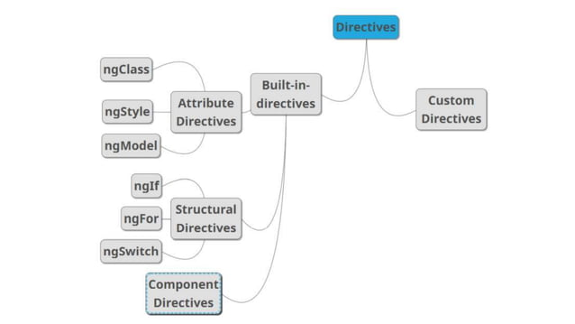

Slide 11
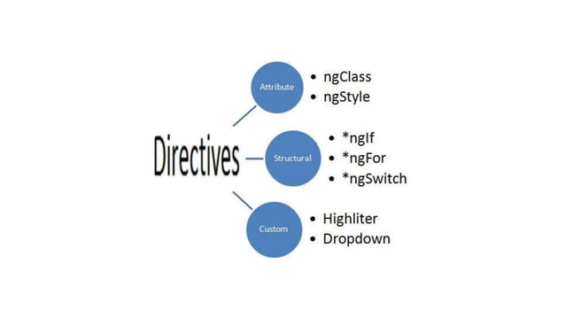

Slide 12
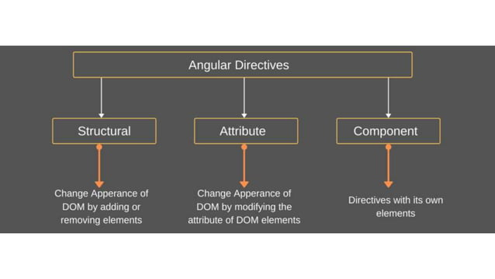

Slide 13
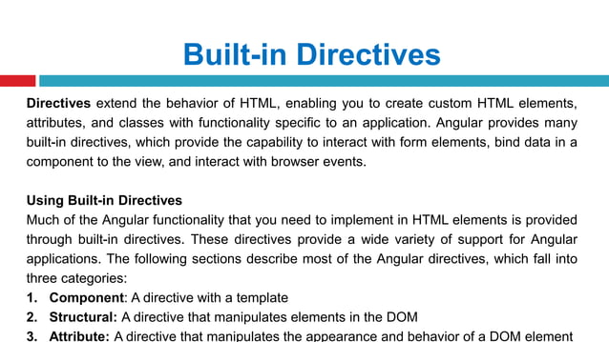

Slide 14
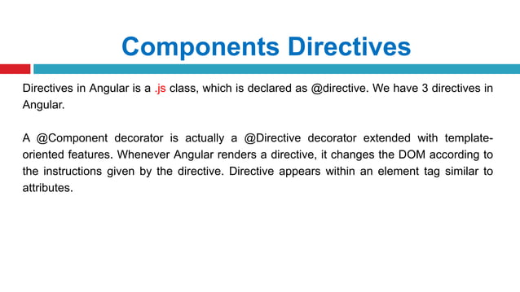

Slide 15
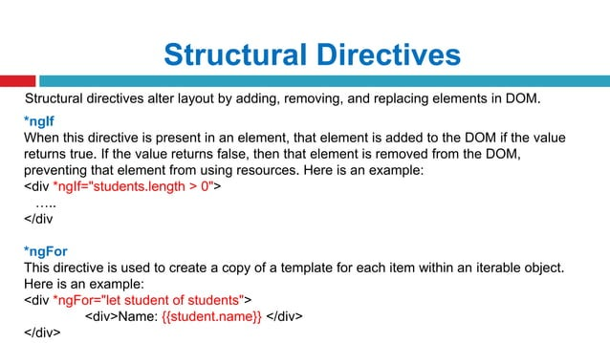

Slide 16
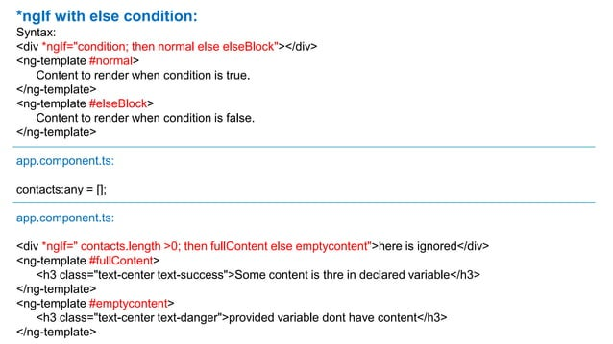

Slide 17
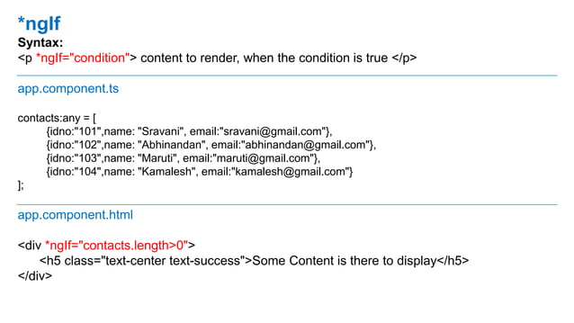

Slide 18
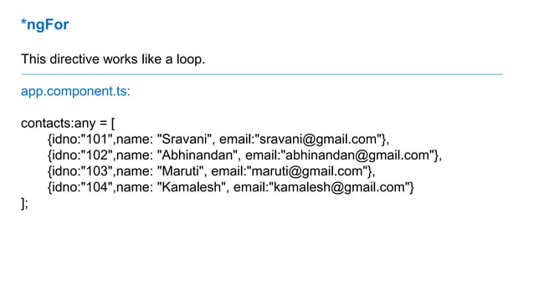

Slide 19
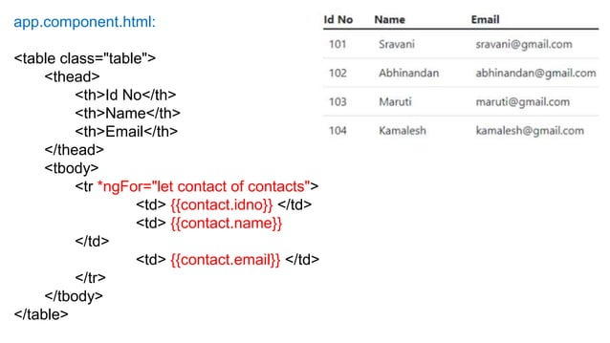

Slide 20
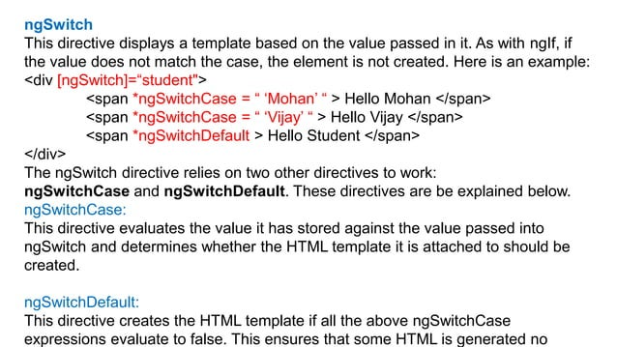

Slide 21
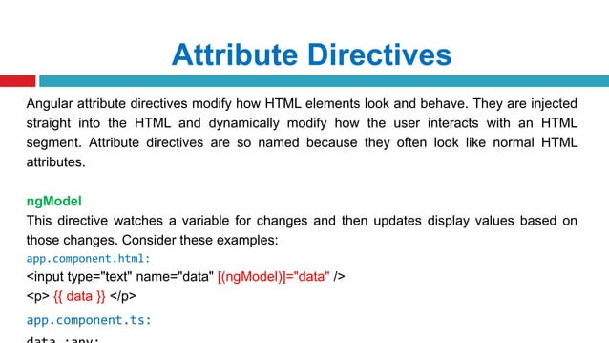

Slide 22
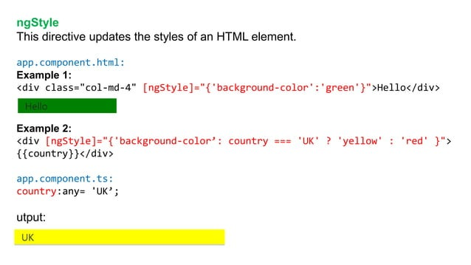

Slide 23
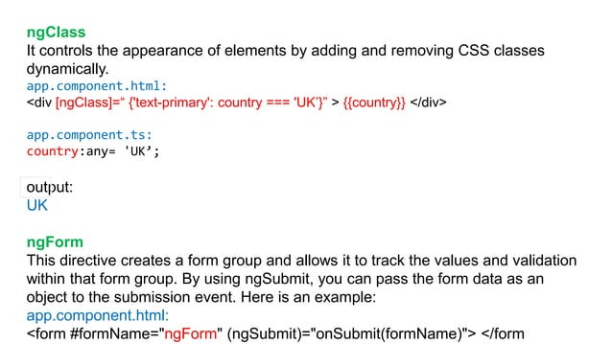

Slide 24
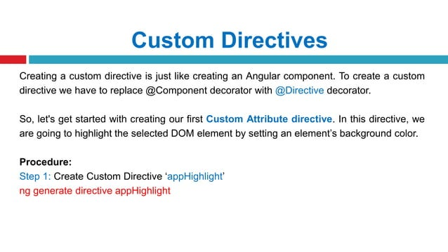

Slide 25
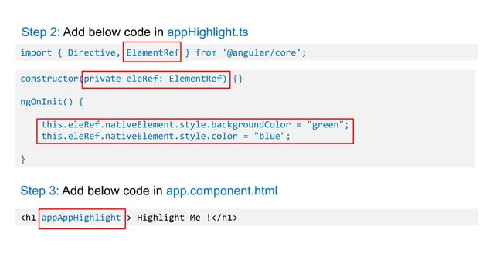

Slide 26
Angular Services and Dependency Injection
Angular Services:
In Angular, a service is a class that provides a specific functionality or business logic to different parts of an application. Services are typically used for tasks such as:
Data Access: Fetching data from a server or interacting with APIs.
Business Logic: Performing complex computations or handling business rules.
State Management: Sharing data and state across different components.
Dependency Injection (DI):
Definition: Dependency Injection is a design pattern used to manage the dependencies of a class. In Angular, DI allows you to inject services or other dependencies into components or services rather than creating them directly. This helps in achieving loose coupling and improves the testability of your code.

Slide 27
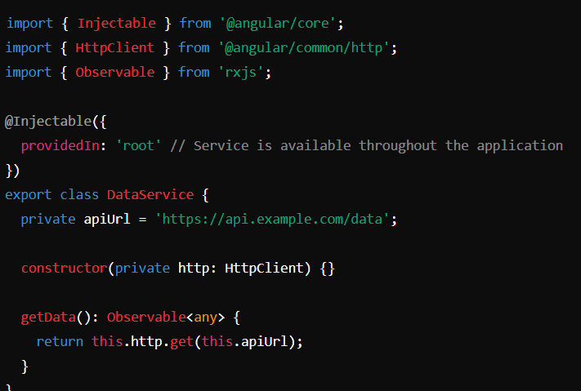
Example of a Service:

Slide 28
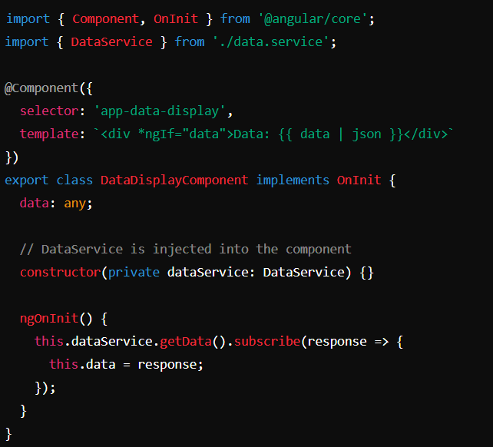
Example of Dependency Injection:

Slide 29
Forms
Template-Driven Forms
Template-Driven Forms are built using Angular directives in the HTML template. They rely heavily on Angular's two-way data binding and are suitable for simpler forms.
This approach is more declarative, with most of the logic embedded within the template.
Key Features:
Two-Way Data Binding: Uses [(ngModel)] to bind form inputs to properties in the component class.
Directives: Uses Angular directives like ngModel, ngForm, and ngModelGroup to create and manage forms.
Simplicity: Easier to use for simple forms but can become less maintainable for complex forms.

Slide 30
Example for tem form
<form #myForm="ngForm" (ngSubmit)="onSubmit(myForm)">
<label for="name">Name:</label>
<input id="name" name="name" [(ngModel)]="user.name" required />
<label for="email">Email:</label>
<input id="email" name="email" [(ngModel)]="user.email" required email />
<button type="submit" [disabled]="myForm.invalid">Submit</button>
</form>
export class UserFormComponent {
user = { name: '', email: '' };
onSubmit(form: any) {
console.log('Form Submitted!', form.value);
}

Slide 31
Reactive Forms
Reactive Forms (also known as Model-Driven Forms) are built around a more programmatic approach, offering greater control and flexibility. They are best suited for complex forms and advanced validation scenarios.
This approach emphasizes an explicit and imperative programming model.
Key Features:
Form Control and Form Group: Uses FormControl, FormGroup, and FormArray classes to manage the form state.
Observable-based: Forms are managed through observables, allowing for more dynamic form handling.
Advanced Validation: Easier to implement complex validation logic.

Slide 32
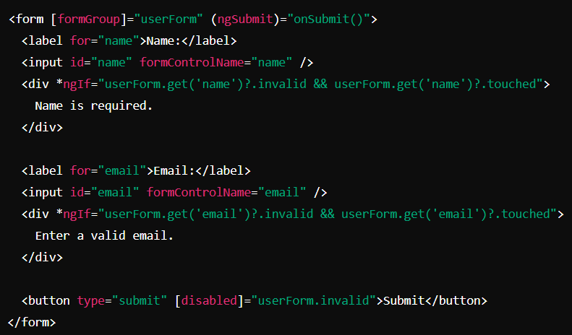
Example

Slide 33
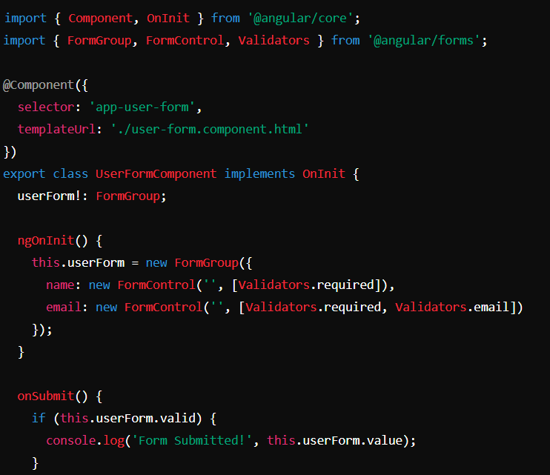
T.s.File

Slide 34
Form Validation and Error Handling
Validation is a key part of building forms in Angular. Both Template-Driven and Reactive Forms support various validation techniques, from basic HTML5 validation attributes to custom validators.
Validation in Template-Driven Forms:
Built-in Validators: Angular provides built-in validators like required, minlength, maxlength, email, etc.
Custom Validators: You can create custom validators by writing functions that return a validation result.
Validation Feedback: Use Angular directives like ngClass or *ngIf to provide feedback to users.

Slide 35
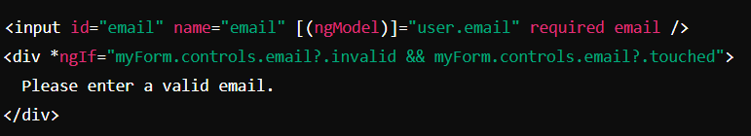
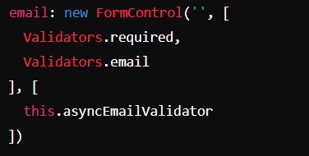
Validation in Reactive Forms:
Built-in Validators: You can apply validators directly in the FormControl definition.
Custom Validators: Create custom validator functions that can be applied in the same way as built-in validators.
Async Validators: Support for asynchronous validation, useful for scenarios like checking if a username is already taken.

Slide 36
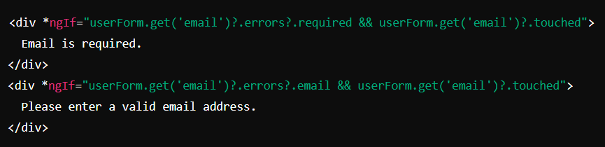
Error Handling:
Form Control States: Use states like valid, invalid, touched, untouched, dirty, and pristine to manage and display validation errors.
Global Error Handling: Create a global error handling service or component to manage form errors consistently across the application.

Slide 37
Angular Routing and Navigation
Angular's routing module allows you to create Single Page Applications (SPAs) by navigating between different views or components without reloading the entire page. Below is a detailed explanation of setting up routing, navigating between routes, passing data, route guards, and lazy loading routes.
Setting Up Routing in an Angular Application
Routing in Angular is managed by the Angular Router, which enables navigation between different views or components.
To use routing, you need to set up a RouterModule in your Angular application and define routes.

Slide 38
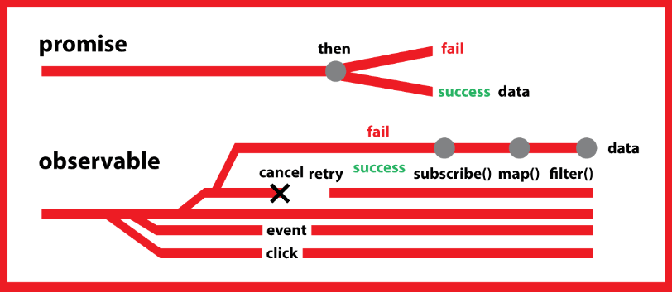
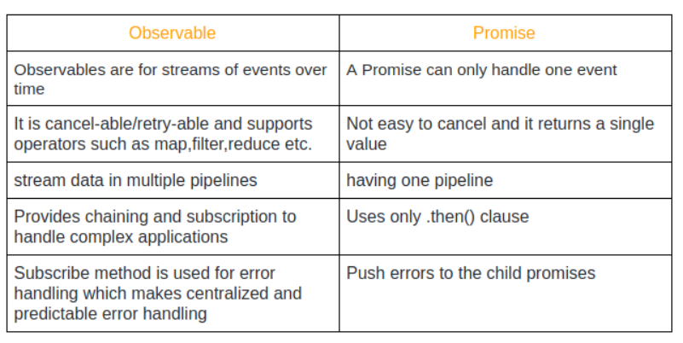
Promise And Observables

Slide 39
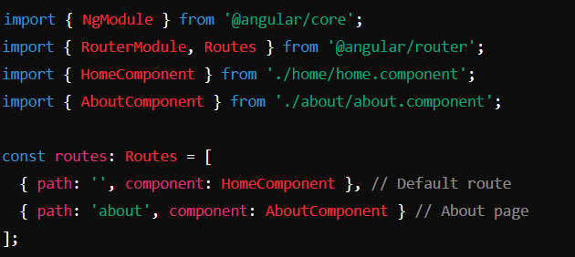
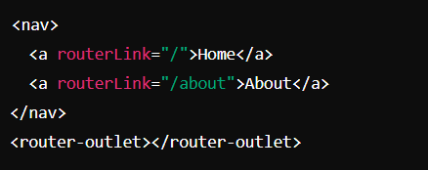
Add Router Outlet:

Slide 40
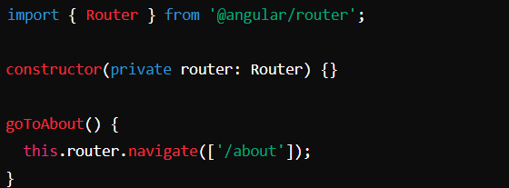
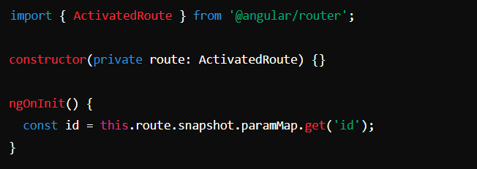
Navigating Between Routes and Passing Data
Navigating Between Routes:
RouterLink: Use the routerLink directive to navigate between routes declaratively.
Router Service: Use the Router service to navigate programmatically.
<a routerLink="/about">Go to About</a>
{ path: 'product/:id', component: ProductComponent }

Slide 41
Lazy Loading
In Angular 17, lazy loading continues to be an essential feature for optimizing the performance of Angular applications. Angular 17 enhances the lazy loading capabilities with better tooling, more intuitive APIs, and improved performance, making it even easier for developers to manage and implement lazy loading effectively
const routes: Routes = [
{
path: 'feature',
loadChildren: () => import('./feature/feature.module').then(m => m.FeatureModule)
}
];
In this example, the FeatureModule will only be loaded when the user navigates to the /feature route.
Improved Performance
Preloading Strategies

Slide 42
Pipes
Angular Pipes are a powerful feature that allows you to transform data in your templates. They are commonly used to format strings, numbers, dates, and other data types. There are built-in pipes provided by Angular, and you can also create custom pipes to handle specific data transformation needs.
Built-in Pipes
Angular comes with several built-in pipes that can be used to transform data directly in your templates. Some of the most commonly used built-in pipes include:
Custom Pipes
Custom pipes are useful when you need to implement specific data transformations that are not covered by the built-in pipes. You can create custom pipes by implementing the PipeTransform interface and using the @Pipe decorator.

Slide 43
Examples of Built-in pipes
DatePipe
<p>{{ today | date }}</p>
<p>{{ today | date:'shortTime' }}</p>
CurrencyPipe
<p>{{ amount | currency }}</p>
<p>{{ amount | currency:'USD':'symbol':'1.2-2' }}</p>
DecimalPipe
<p>{{ pi | number:'1.0-2' }}</p>
PercentPipe
<p>{{ fraction | percent }}</p>
<p>{{ fraction | percent:'1.0-2' }}</p> Custom format
SlicePipe
<p>{{ text | slice:0:5 }}</p>
UpperCasePipe / LowerCasePipe
<p>{{ name | uppercase }}</p> <p>{{ name | lowercase }}</p>
JsonPipe
<pre>{{ user | json }}</pre>

Slide 44
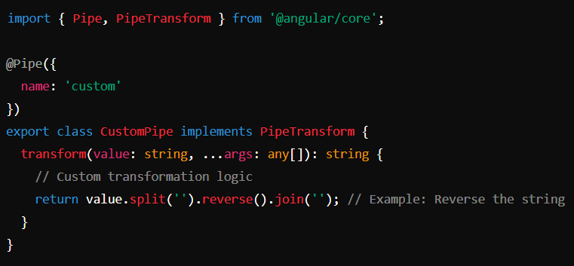
Custom Pipes
Generate a Pipe
ng generate pipe custom

Slide 45
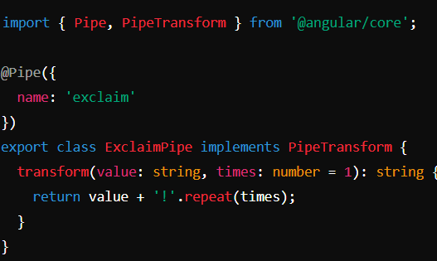
<p>{{ 'Hello' | custom }}</p>
Examples-2
<p>{{ 'Wow' | exclaim:3 }}</p>
Output
<p>Wow!!!</p>

Slide 46
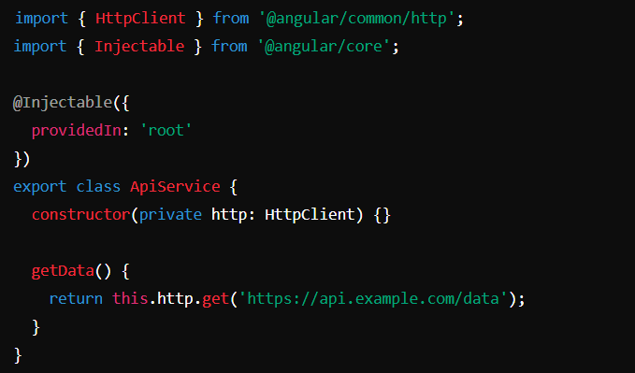
HTTP Client and API Communication
Angular's HttpClient module is a powerful tool for making HTTP requests and handling API communication in your applications. It provides a streamlined way to interact with RESTful APIs, manage responses, handle errors, and work with data formats like JSON
HTTP methods such as GET, POST, PUT, DELETE, and more

Slide 47
getUsers() {
return this.http.get('https://api.example.com/users');
}
Get()
addUser(user: any) {
return this.http.post('https://api.example.com/users', user);
}
Post()
updateUser(id: string, user: any) {
return this.http.put(`https://api.example.com/users/${id}`, user);
}
Put()
deleteUser(id: string) {
return this.http.delete(`https://api.example.com/users/${id}`);
}
Delete()

Slide 48
Lifecycle Hooks
Angular Lifecycle Hooks are methods that allow you to tap into key moments in the lifecycle of a component or directive. These hooks provide a way to react to changes, initialize data, clean up resources, and perform various other tasks at specific points during the lifecycle of a component.
Lifecycle Hooks
Lifecycle Flow:
ngAfterViewChecked()
ngonchanges()
ngAfterViewInit()
Component is initialized.
Inputs are set and checked for changes.
The view is rendered and updated.
The component is destroyed.
ngoninit()
ngAfterContentChecked()
ngOnDestroy()
ngAfterContentInit()
ngDoCheck()

Slide 49
ngOnChanges()
When It’s Called: Before ngOnInit() and whenever one or more data-bound input properties change.
Use Case: Respond to changes in input properties.
ngOnChanges(changes: SimpleChanges) {
console.log('Input properties changed:', changes);
}
ngOnInit()
When It’s Called: Once after the first ngOnChanges() and before the component's view is fully initialized.
Use Case: Perform component initialization, such as fetching data.
ngOnInit() {
console.log('Component initialized');
}
ngDoCheck()
ngDoCheck() {
console.log('Custom change detection logic');
}
When It’s Called: During every change detection run.
Use Case: Implement custom change detection logic.

Slide 50
ngAfterContentInit()
When It’s Called: After Angular projects external content into the component’s view.
Use Case: Respond after content projection is done.
ngAfterContentInit() {
console.log('Content has been projected');
}
ngAfterContentChecked()
When It’s Called: After every check of the projected content.
Use Case: Respond after the content is checked
ngAfterContentChecked() {
console.log('Projected content checked');
}
ngAfterViewChecked()
When It’s Called: After every check of the component's view.
Use Case: Respond after the view is checked.
ngAfterViewChecked() {
console.log('Component view checked');
}
ngOnDestroy()
When It’s Called: Just before Angular destroys the component.
Use Case: Clean up resources, unsubscribe from observables, detach event handlers, etc.
ngOnDestroy() {
console.log('Component destroyed');
}

Slide 51
Material
Angular Material is a UI component library for Angular developers, providing a range of pre-built, customizable UI components that follow the Material Design guidelines by Google. It helps you build consistent, responsive, and visually appealing user interfaces with ease.
Install Material:
ng add @angular/material
https://material.angular.io/
Examples Buttons:
Angular Material buttons come with built-in styles and animations. You can easily create different types of buttons like raised, flat, and icon buttons.
<button mat-button>Basic Button</button>
<button mat-raised-button>Raised Button</button>
<button mat-icon-button>
<mat-icon>favorite</mat-icon>
</button>

Slide 52
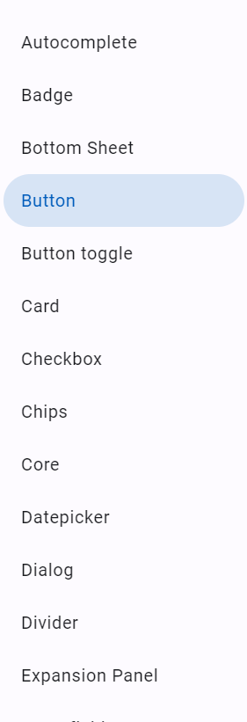
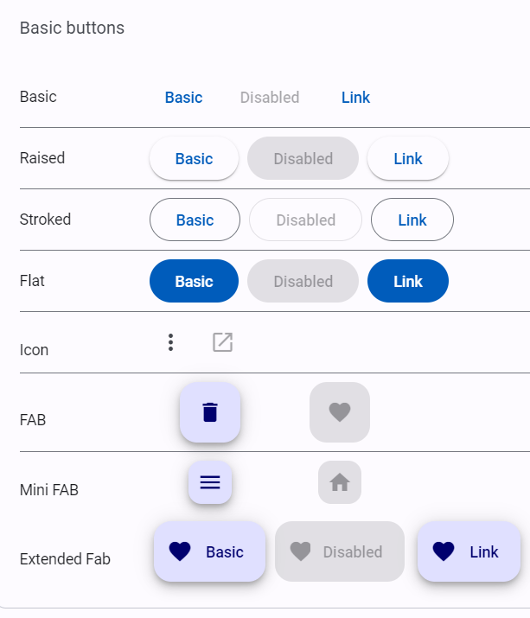
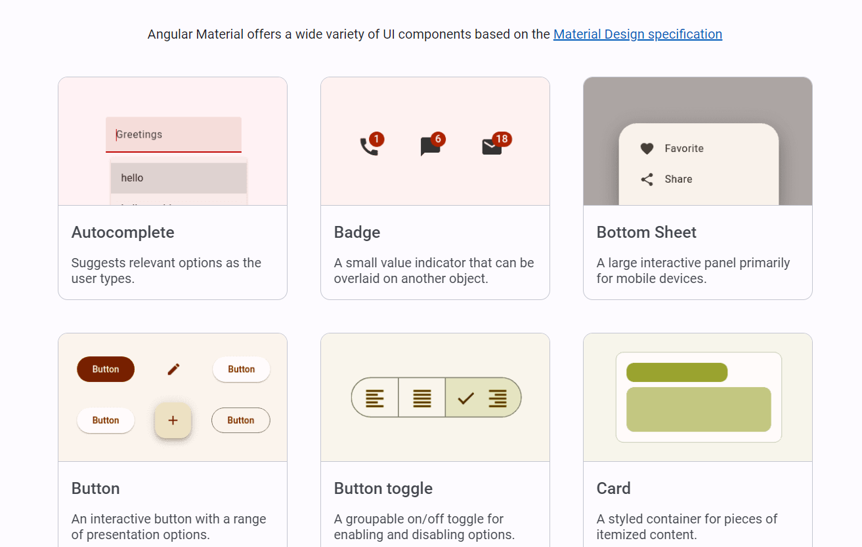

Slide 53
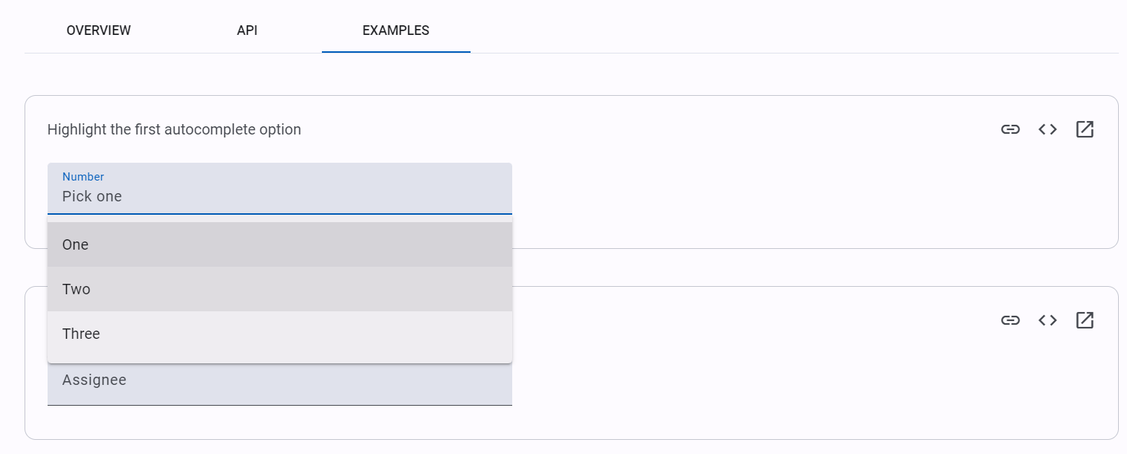
<mat-icon aria-hidden="false" aria-label="Example home icon" fontIcon="home"></mat-icon>
<mat-list> <mat-list-item>Item 1</mat-list-item> <mat-divider></mat-divider> <mat-list-item>Item 2</mat-list-item> <mat-divider></mat-divider> <mat-list-item>Item 3</mat-list-item> </mat-list>
<mat-form-field>
<mat-label>Choose a date</mat-label>
<input matInput [matDatepicker]="picker">
<mat-hint>MM/DD/YYYY</mat-hint>
<mat-datepicker-toggle matIconSuffix [for]="picker"></mat-datepicker-toggle>
<mat-datepicker #picker></mat-datepicker>
</mat-form-field>

Slide 54
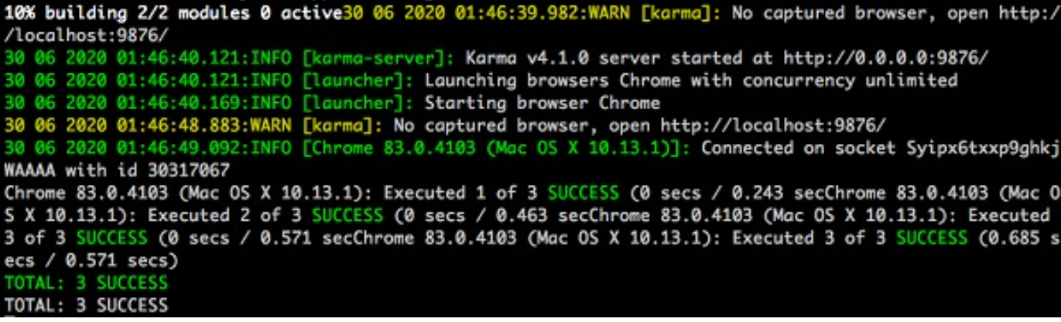
Testing
Testing is a very important phase in the development life cycle of an application. It ensures an application quality. It needs careful planning and execution.
Unit Test
Unit testing is the easiest method to test an application. It is based on ensuring the correctness of a piece of code or a method of a class. But, it does not reflect the real environment and subsequently. It is the least option to find the bugs.
Ng test

Slide 55
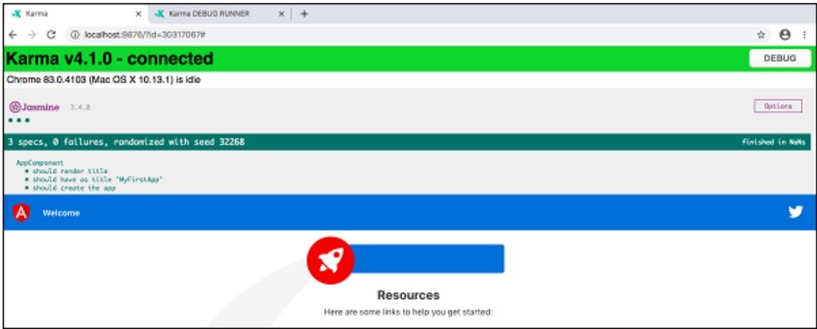
Now, Chrome browser also opens and shows the test output in the “Jasmine HTML Reporter”. It looks similar to this,
End to End (E2E) Testing
Unit tests are small, simple and fast process whereas, E2E testing phase multiple components are involved and works together which cover flows in the application. To perform e2e test, type the below command

Slide 56
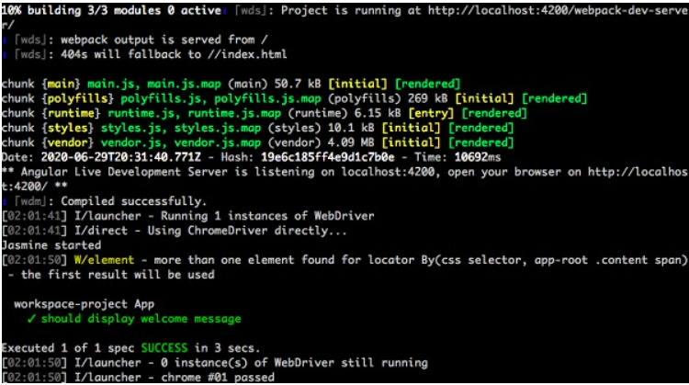
Ng e2e

Slide 57
Ahead-of-Time (AOT)
AOT compilation is a process that compiles Angular templates and components into highly efficient JavaScript code during the build phase, rather than at runtime. This reduces the size of the bundle and speeds up the rendering of the application.
Benefits of AOT:
Faster Rendering: The browser downloads a pre-compiled version of the application, resulting in faster rendering.
Smaller Bundles: AOT removes Angular decorators and other unnecessary code from the final bundle.
Improved Security: AOT compiles templates into JavaScript, preventing injection attacks.
AOT is enabled by default in production builds. You can explicitly use it in development by adding the --aot flag.
ng build --aot

Slide 58
Just In Time (JIT) Compiler
In Just In Time (JIT) compilation, the compiler will be bundled along with the application and send to the browser. Angular application will be compiled in the browser and run just before the execution of application.
Production Builds:
When building an application for production, Angular provides optimizations to ensure the best performance.
Production Build Features:
Minification: Removes unnecessary white spaces, comments, and code to reduce the bundle size.
Uglification: Renames variables and functions to shorter names to further reduce the size.
Dead Code Elimination: Removes unused code from the final bundle.
ng build --prod

